Slide 1

FMO Case Study
SPREAD Course 2016, Settat, Sorin Petrescu - Geocycle
© 2015 Holcim Technology Ltd

Slide 2
Objectives
Getting familiar with the FMO
Being able to quickly calculate GAV, STEC, TSR and TEE for a fuel mix
Optimize fuel mix (lowest SACTE) using Excel Solver with various constraints
→ Use the FMO in your PPE project (if applicable) and definition/review of AF strategy

Slide 3
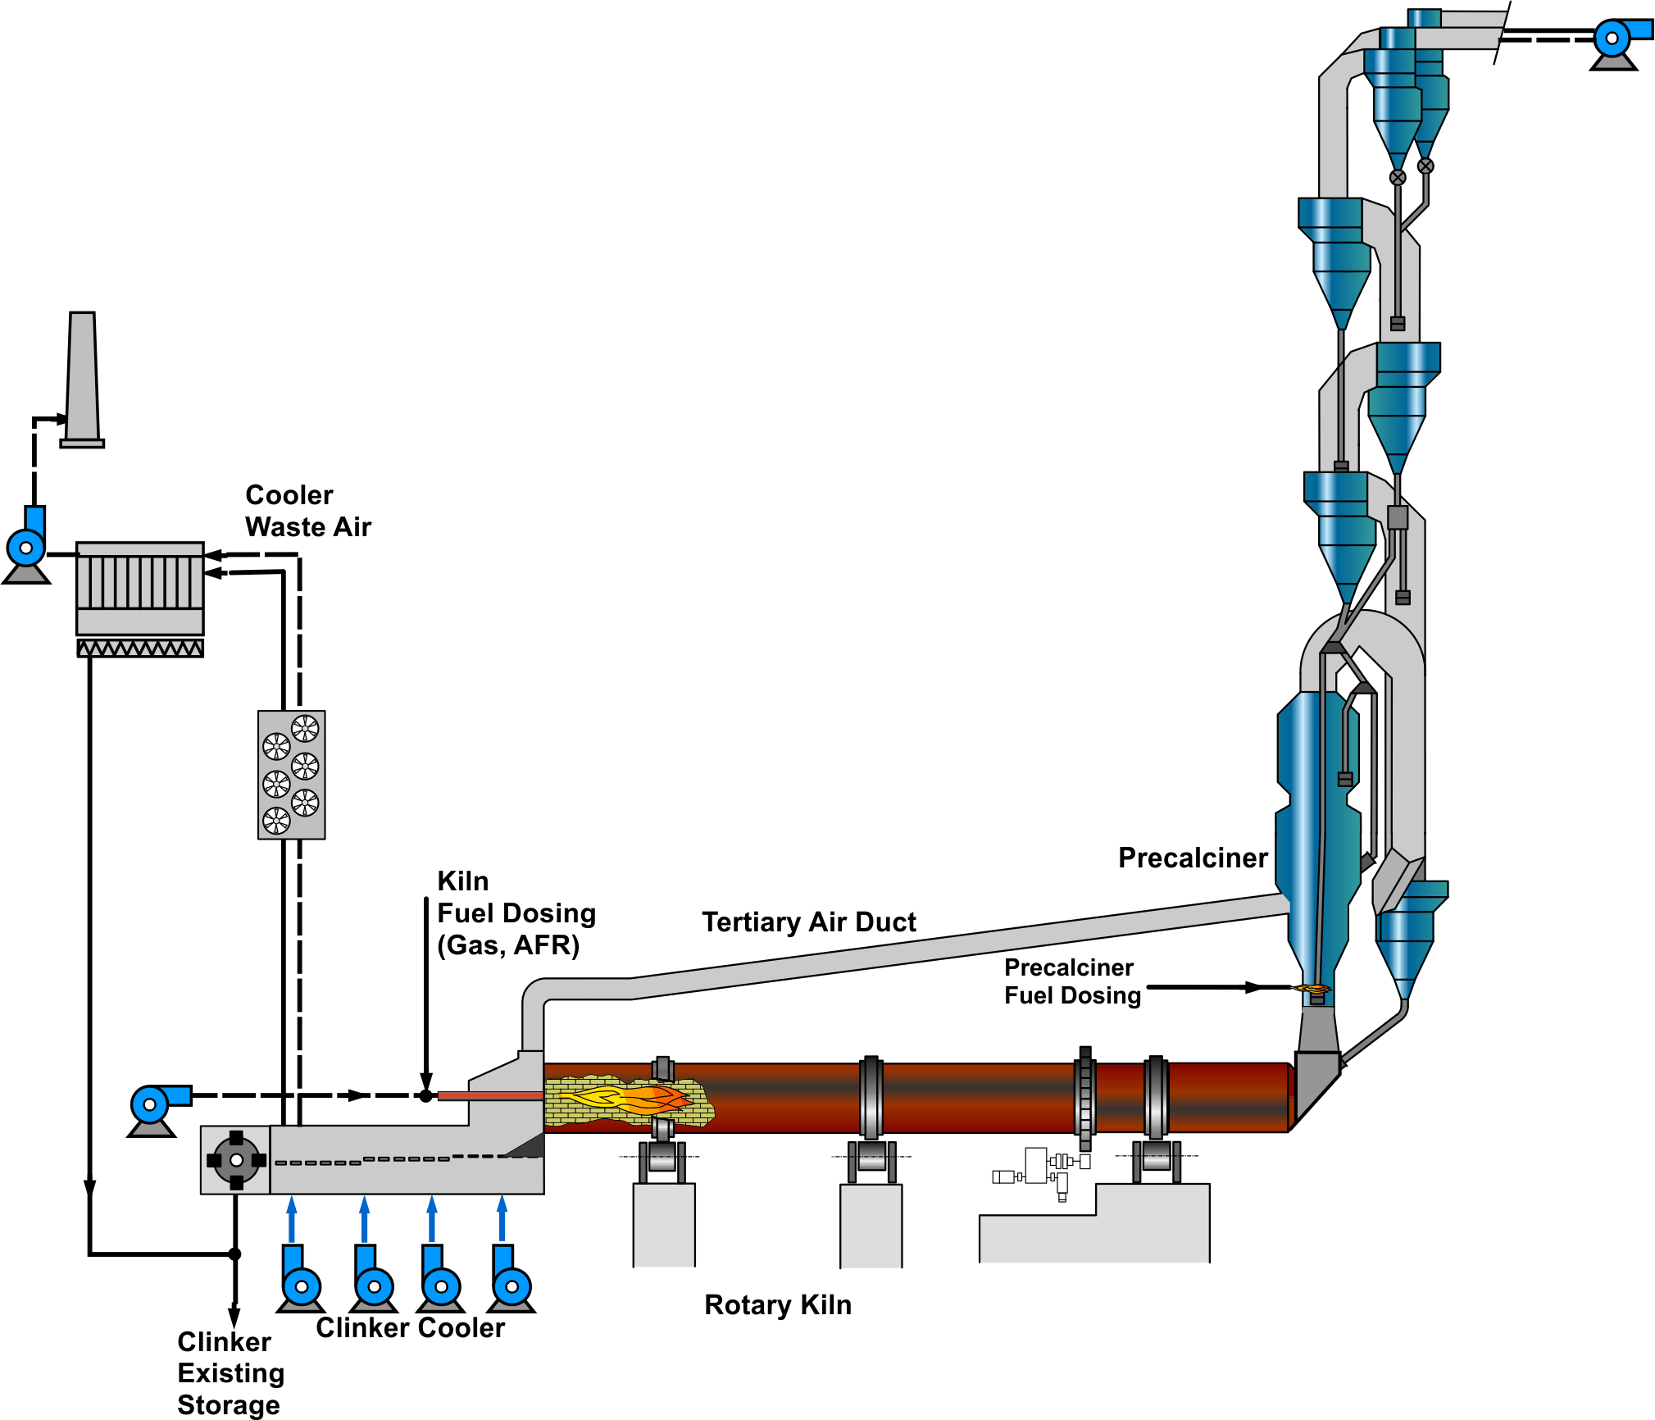
GEOCEM plant
In-line precalciner (ILC) kiln
Capacity 4’500 t_{cli}/d
STEC 3’300 kJ/kg_{cli}
Traditional fuel is coal at 5.4 USD/GJ
12% kiln exhaust gas handling capacity reserves
No immediate impact on EBITDA by clinker production loss
No AFRs used so far
Assume all AF installations (pre-processing, feeding, etc.) are available for all the material streams
Simultaneous feeding of all streams possible
No kiln gas bypass and no CKD extraction

Slide 4
Most of the needed information is already in the FMO
The handed-out FMO is already complete with the required information:
kiln system type
gas flow reserves
fuel category, properties and cost
Cl from raw materials
SO3 and alkalis in clinker
…

Slide 5
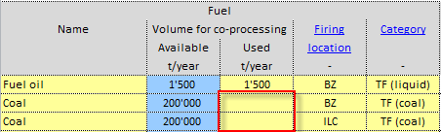
TASK 1: Finish baseline information
Enter the kiln Production Rate Index (PRI) and Gross Availability Index (GAI). PRI=95%, GAI=89.5%. How many t clinker/year did you produce?
Adjust by hand (trial and error) the coal volumes at BZ and ILC
How many tons of coal are needed need at BZ and ILC?
Match the target heat consumption
Adjust for 40% heat input at the main burner (BZ)

Slide 6
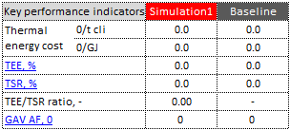
TASK 2: Use liquid AF and contaminated water
Use 10’000 t/a each for contaminated water, solvents and emulsions.
Waste water injection into the precalciner.
Solvents and emulsion can be used at the main burner.
Adjust again by hand the coal volumes at BZ and ILC
Match the target heat consumption and maintain 40% heat input at the BZ with the additional liquid streams.
Note results and main KPI’s
Additional heat consumption by AF: _ _ _ kJ/kg cli
Look at the key indicators
How much does Cl input increase? _ _ _ g/t cli
Discuss absolute GAV per AF stream as well as specific GAV per GJ or GAV per ton (see columns AB..AD).
What is the specific average fuel cost (USD/GJ) for all the liquids.

Slide 7
TASK 3: Use and optimize solid AF in the precalciner
t/a
Additionally available solid and sludgy AF volumes:
select the appropriate fuel categories for new streams Constraints:
Assume limit of max. 45% TSR at your ILC (75% of heat input to ILC by AF).
Max. 5% TSR with sludge to the kiln riser duct just above the kiln inlet. It is fed by a piston pump but cannot be atomized with current installation.
Respect the Cl limit.
Program the Solver together with your coach.
Minimize SACTE (USD/t cli) with the given constraints.
Which and how much of the individual AF streams are chosen?
Study and discuss the Key Indicators.
What effect you see on SO3 in clinker, A/S ratio by using AF?
How much is the annual fuel cost savings (USD/year) compared to Baseline?
Have a look at the Summary sheet: How much SB and NCB do you make?

Slide 8
TASK 4: “Play” with the FMO
Global economic slow-down led to decrease of the coal price and procurement negotiated excellent contract for the same coal: →110 USD/t at plant gate.
How much does the SACTE change (USD/GJ), how much the GAV? (set the value back to 125 USD/t after the evaluation)
We extract CKD during direct operation and use it in the cement.
How does the “optimal” fuel mix change? Which streams are increased/decreased? Discuss why.
How much could you increase GAV?
Are exhaust gas capacity reserves enough to prevent production loss?
Assume that the exhaust gas handling capacity is only 6% (not 12%)
How much impact on clinker production do we expect?
What would be possible process optimizations or kiln modifications to avoid impact on clinker production?

